Slide 1
Mathematical Preliminaries
Introduction to Deep Learning
Module 1, Class 3

Slide 2
Pre-read
Paul’s online notes, section 13.2 (Partial Derivatives), 13.3 (Interpretation), 13.6 (Chain Rule), 13.7 (Directional Derivatives): Do the examples
https://www.khanacademy.org/math/linear-algebra/vectors-and-spaces
Covers vector addition, scalar multiplication, dot product, and length (norms) with visualizations.
NumPy Tutorial: Linear Algebra Basics, for practice with numpy.dot, numpy.linalg.norm, and other operations
Matrix Calculus, Sections 1.1, 1.2, 1.3, 2.1.1.

Slide 3
Agenda
Introduction to derivatives in multiple dimensions
Geometric interpretation
Chain rule in a computational graph
Using partial derivatives to solve linear regression

Slide 4
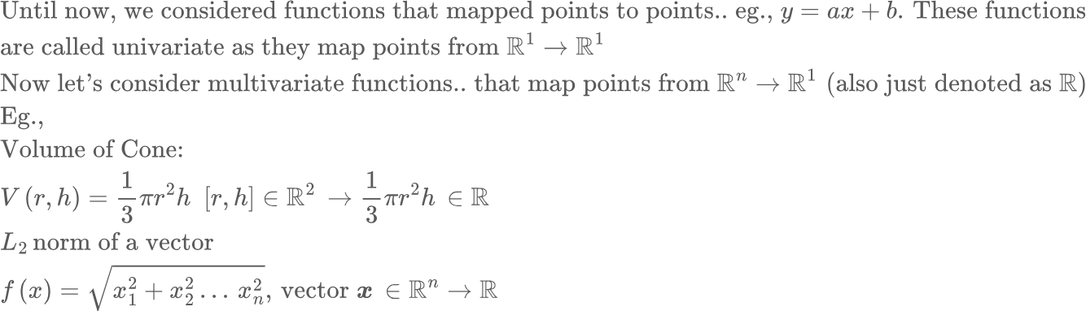
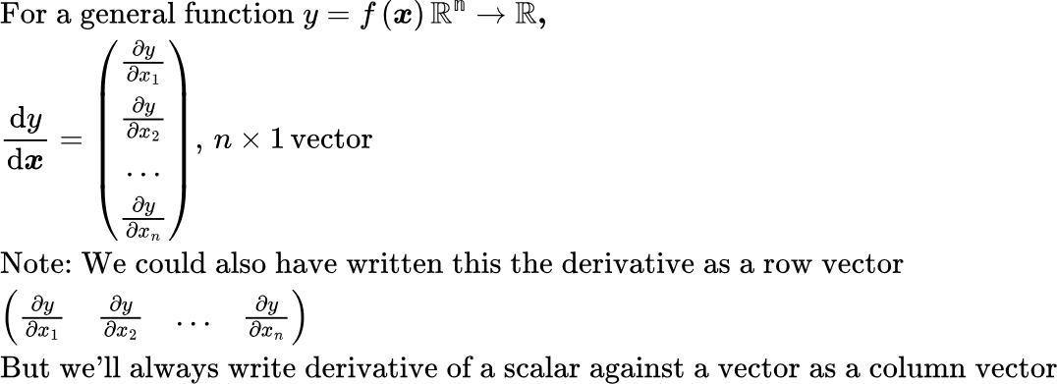
Partial Derivatives
Note we are considering the derivative of a scalar against a vector!

Slide 5
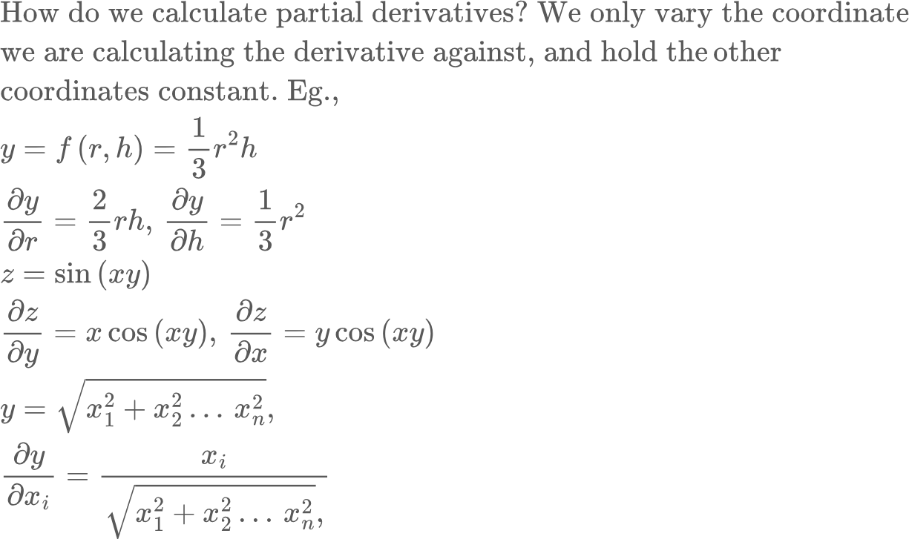
Partial Derivatives
Partial derivative along one coordinate is the same as regular derivative if we treat the other dimensions as a constant
The total derivative is now a vector, with the partial derivatives forming the coordinates along each axis. The total derivative vector still points in the direction of the steepest ascent!
Partial derivatives can depend on all dimensions, a single dimension and anything in between. They can also be a constant, including 0
See: verify_partial_derivatives.py

Slide 6
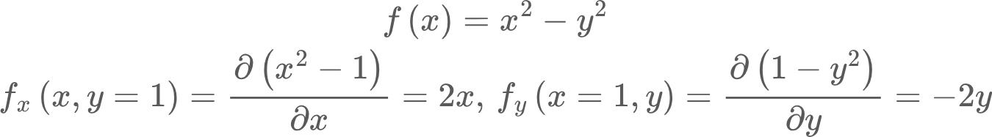
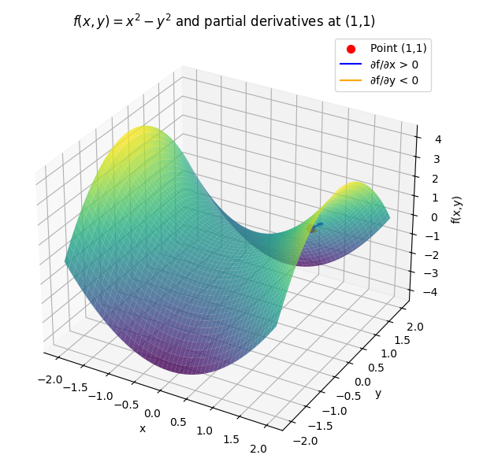
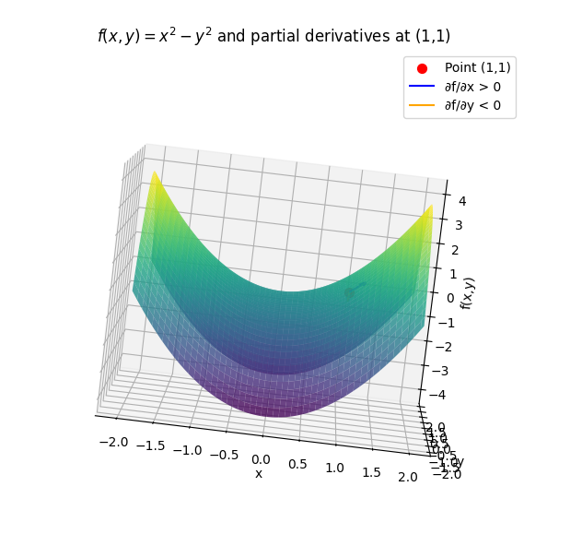
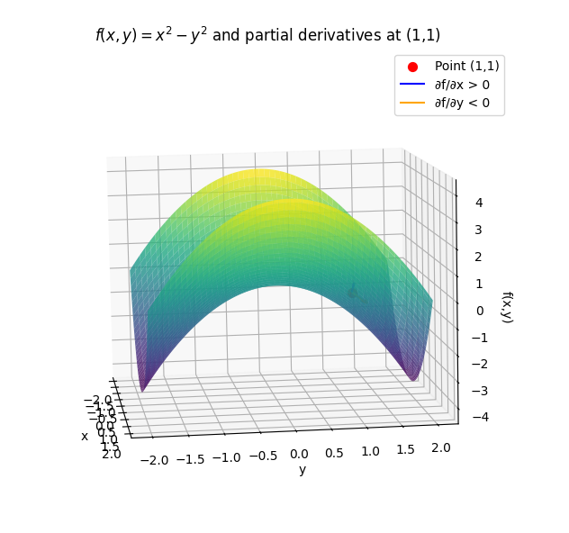
Partial Derivatives: Interpretation
Partial derivative along one coordinate is the same as regular derivative if we treat the other dimensions as a constant

Slide 7
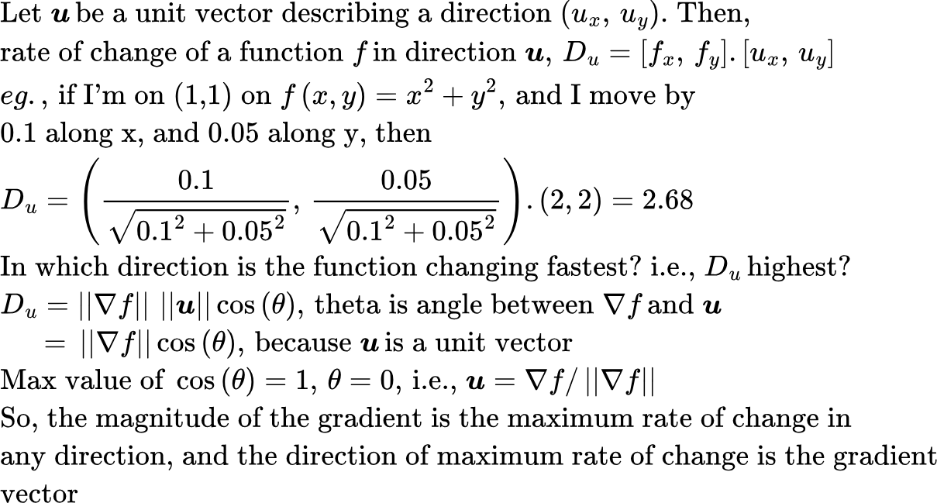
Partial Derivatives: Interpretation
From a point x0, y0, there are an infinite number of directions I could move. The function can change by different amounts in each direction. I can ask two questions:
If I move in direction (u,v), what is the rate of change?
In which direction is the rate of change maximum, and what is the value of that rate of change?

Slide 8
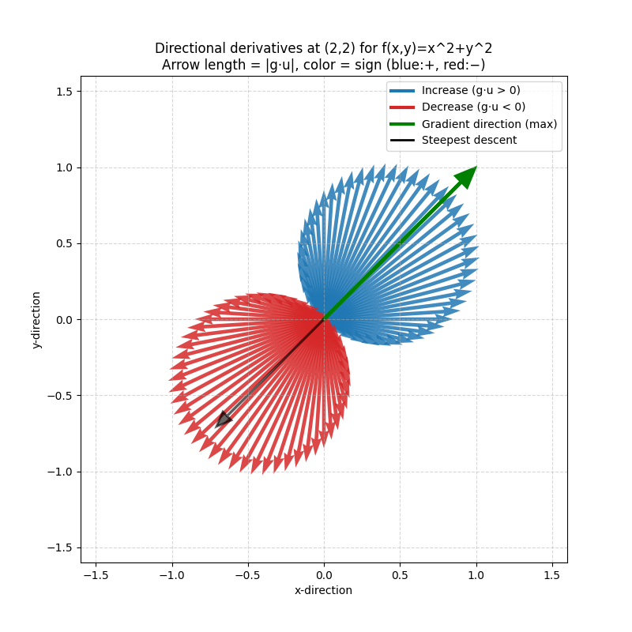
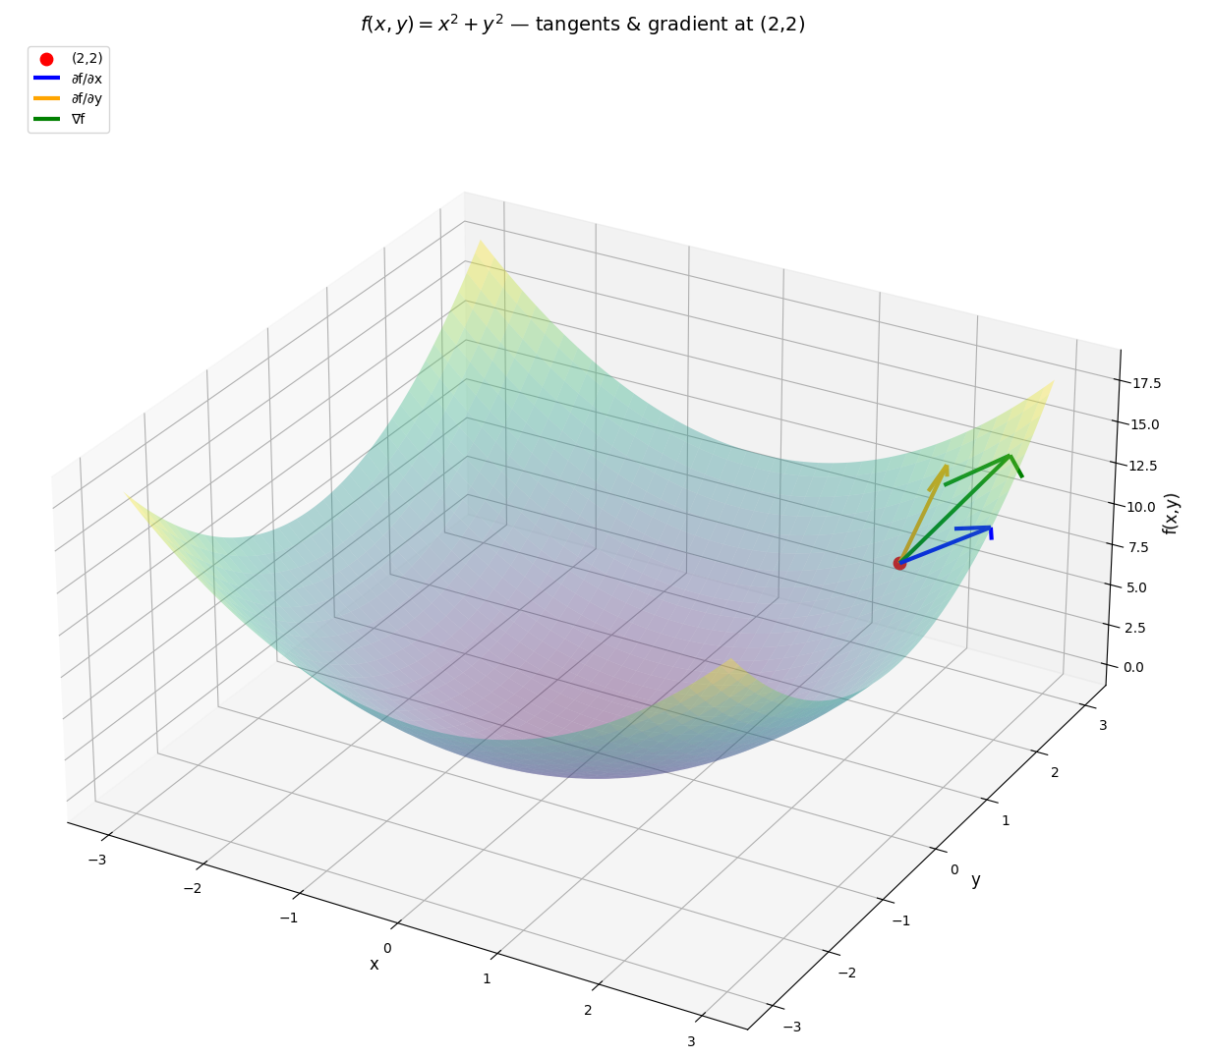
Partial Derivatives: Interpretation
See: direction_derivatives.py

Slide 9
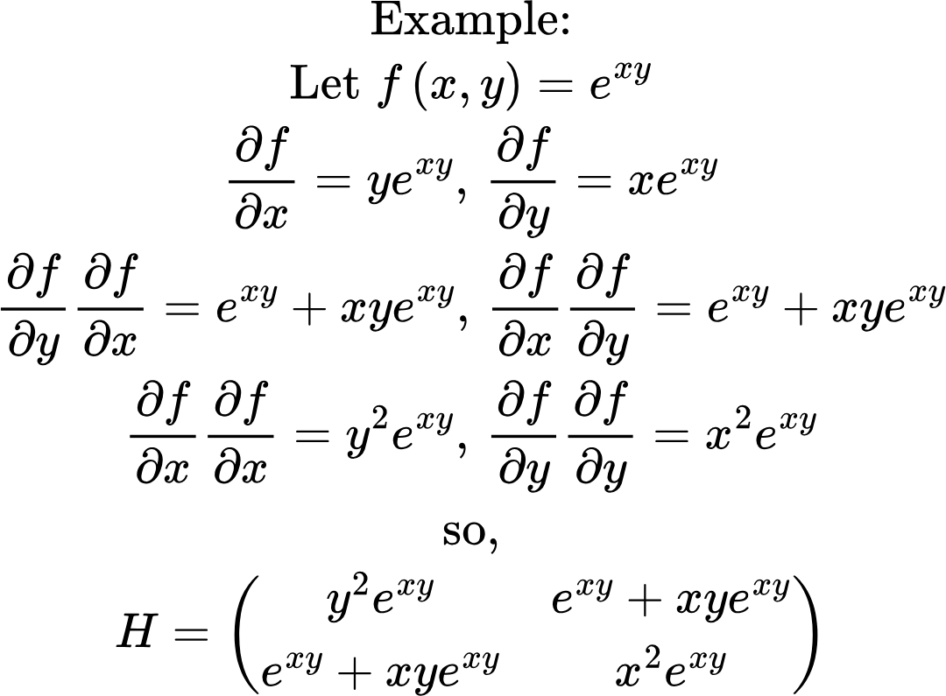
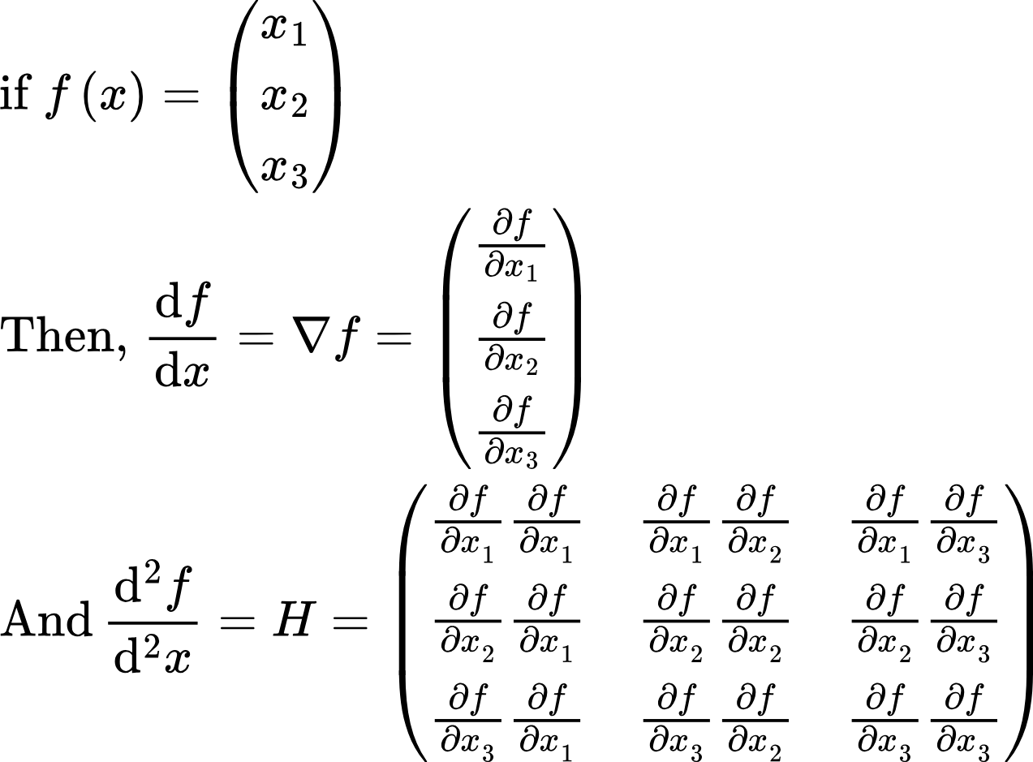
Hessian Matrix
Hessian matrix is a matrix of second derivatives.

Slide 10
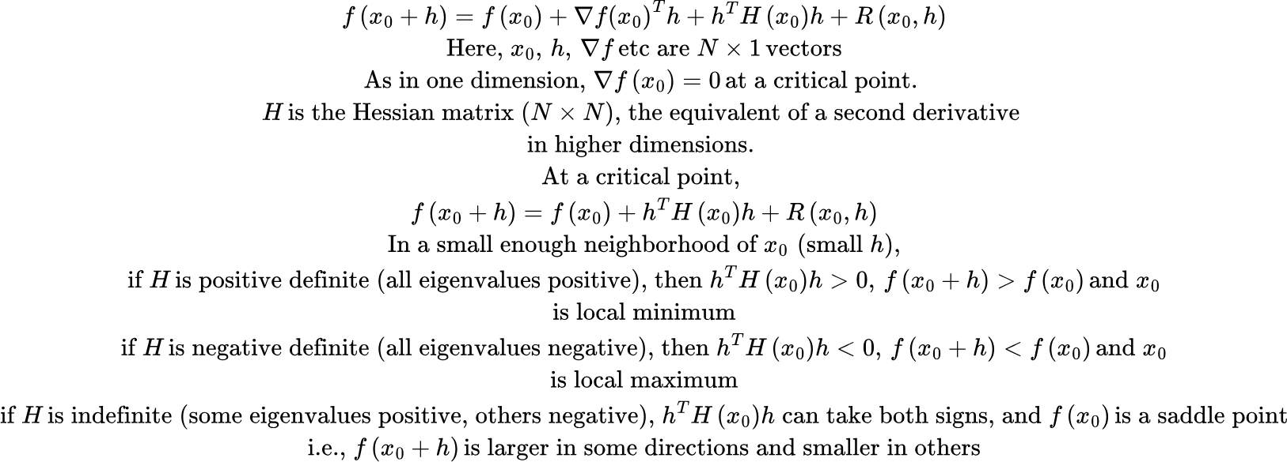
Critical points for multivariate functions
To find a critical point (local minimum/maximum) for a univariate function, we set the derivative to 0 and use the second derivative test to determine whether the critical point is a minimum or maximum. What’s the counterpart of this in higher dimensions?

Slide 11
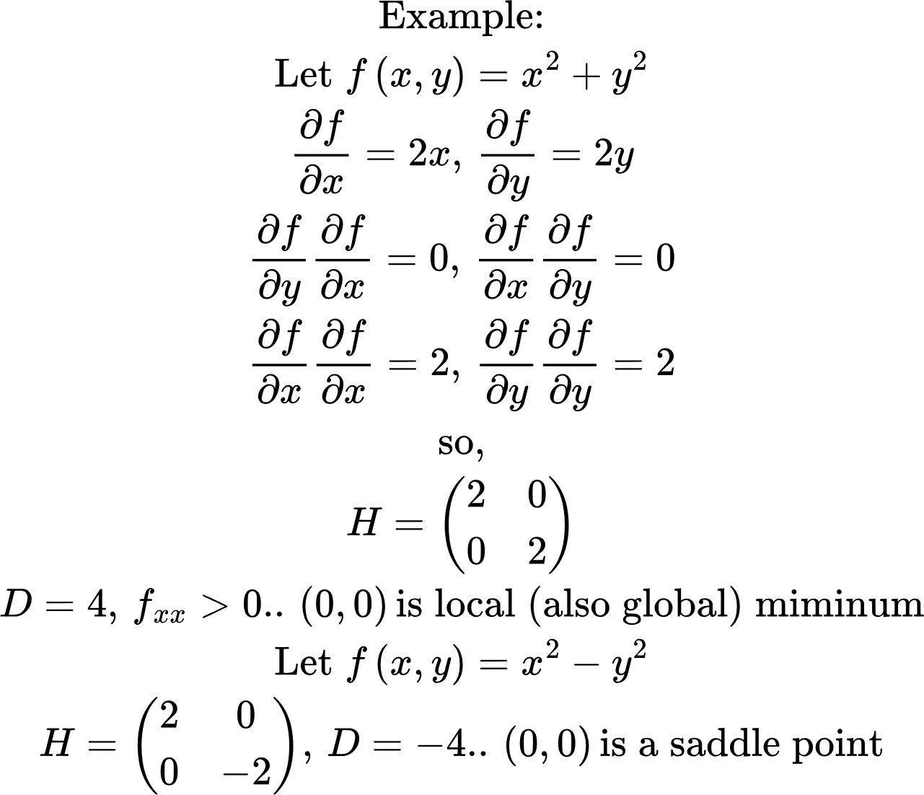
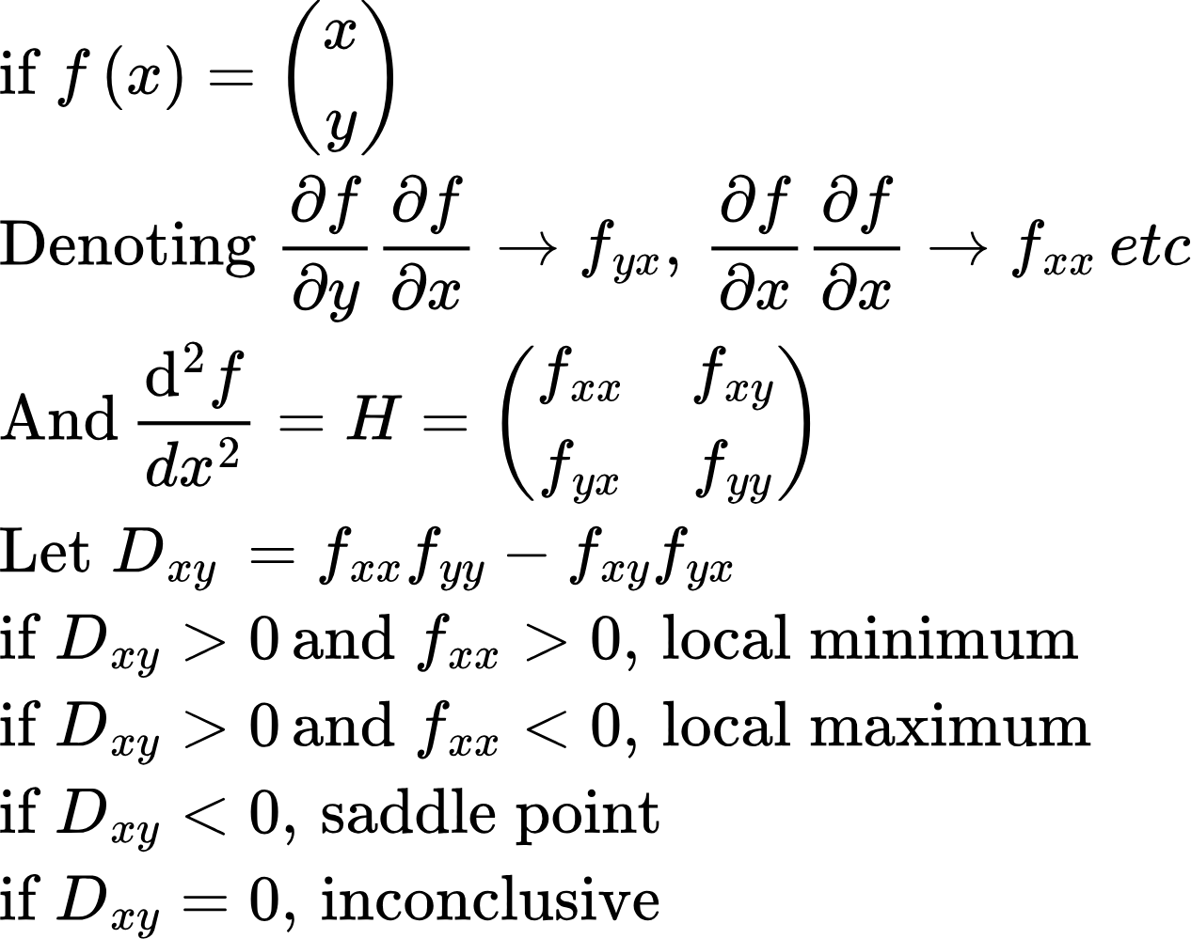
Second Derivative Test in 2D..
In 2D,

Slide 12
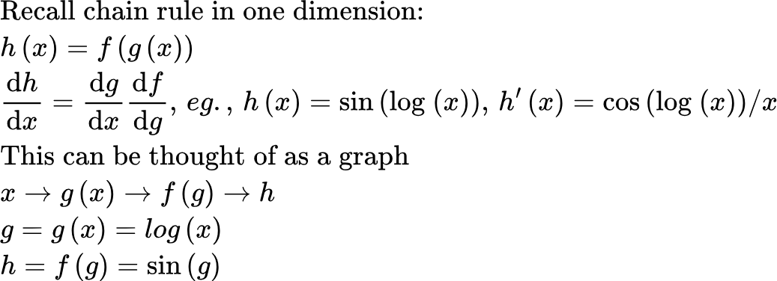
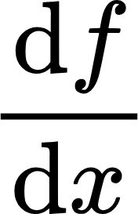
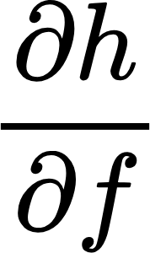
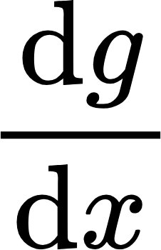
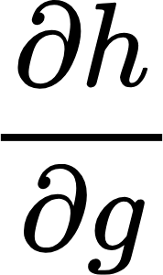
Partial Derivatives: Chain Rule
We can generalize this to multiple dimensions as follows:
f(x)
Backward pass
x
h(f(x), g(x))
y
Forward Pass
g(x)

Slide 13
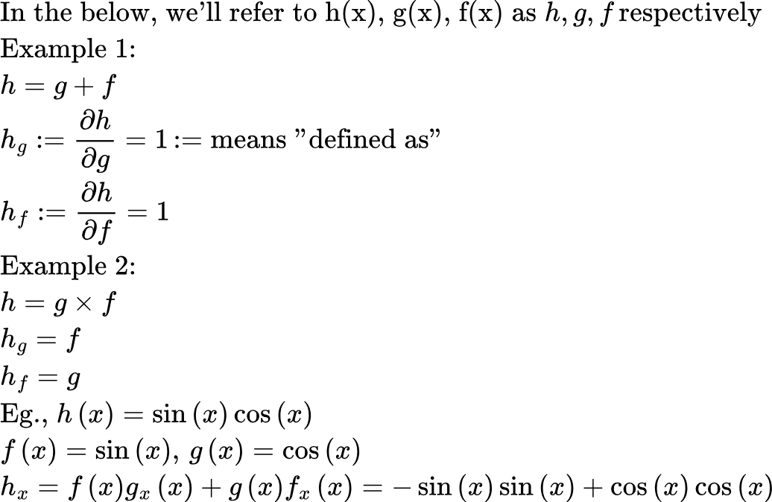
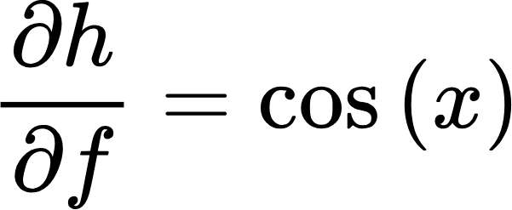
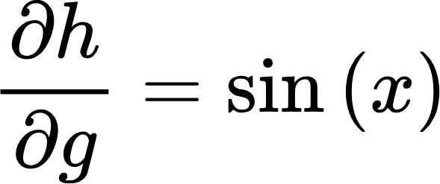
Partial Derivatives: Chain Rule
sin(x)
x
sin(x)cos(x)
y
cos(x)

Slide 14
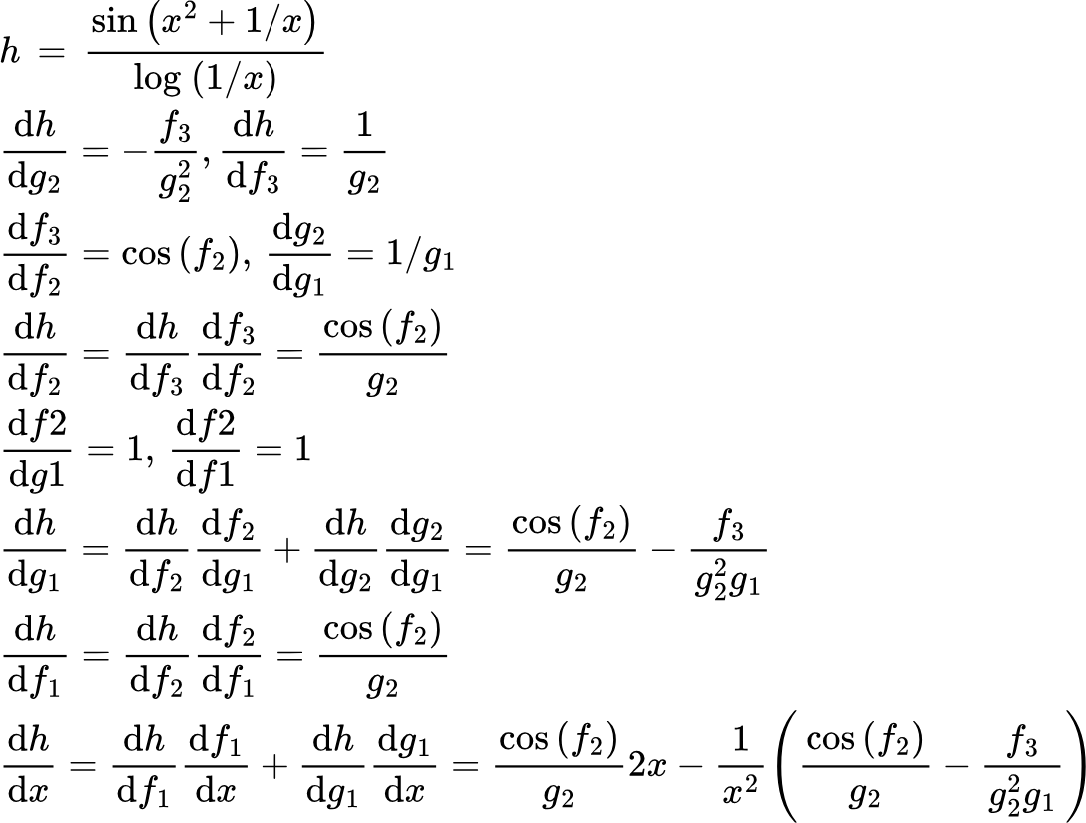
Partial Derivatives: Chain Rule
More complicated example
f1=x^2
f2=(+)
f3=sin(f2)
x
h=f3/g2
y
g1=1/x
g2=log(g1)
This is the interesting part! g1 gets gradients from f2 and g2
See: chain_rule.py

Slide 15
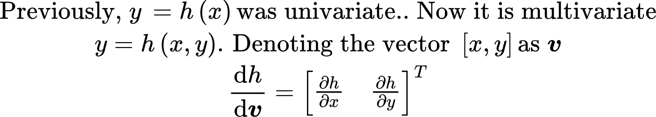
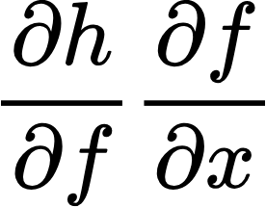
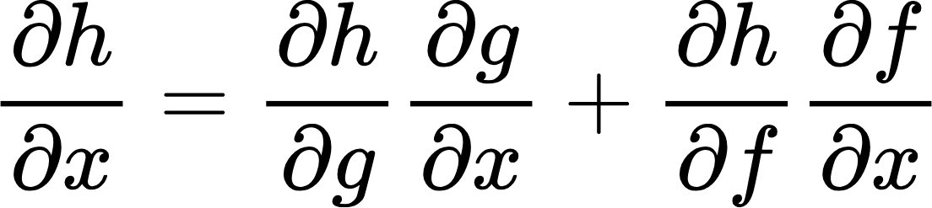
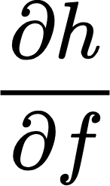
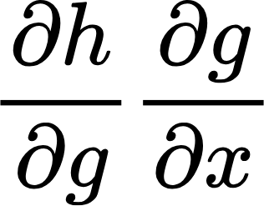
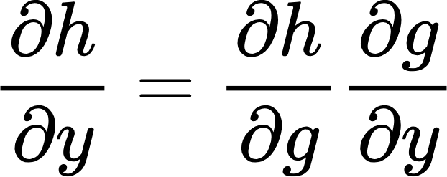
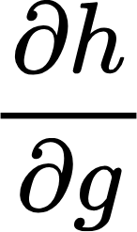
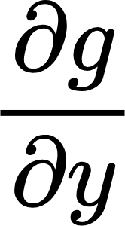
Partial Derivatives: Chain Rule
Multivariate case
x
f(x)
h(f(x), g(x,y))
y
y
g(x,y)

Slide 16
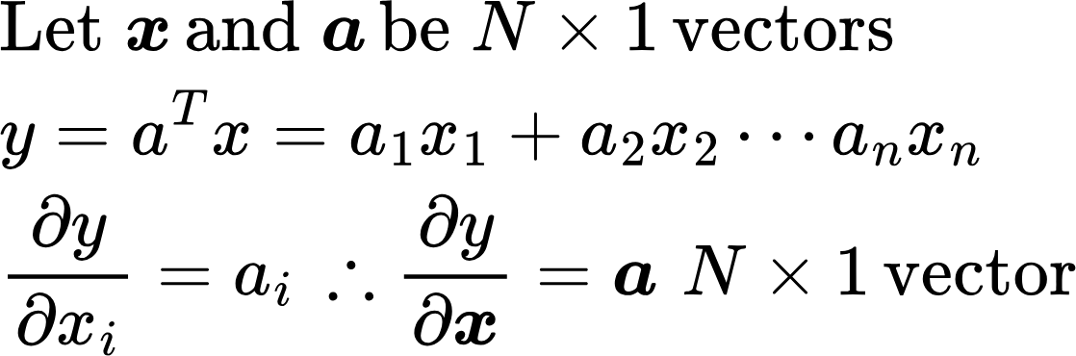
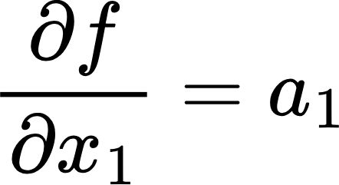
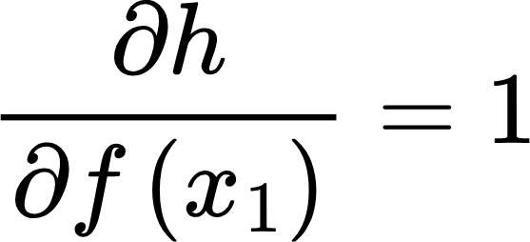
Linear case
x1
f(x1)=a1 x1
x2
f(x2)=a2 x2
h=f(x1)+f(x2)... f(xn)
y
xn
f(xn)=an xn
See: verify_partial_derivatives.py

Slide 17
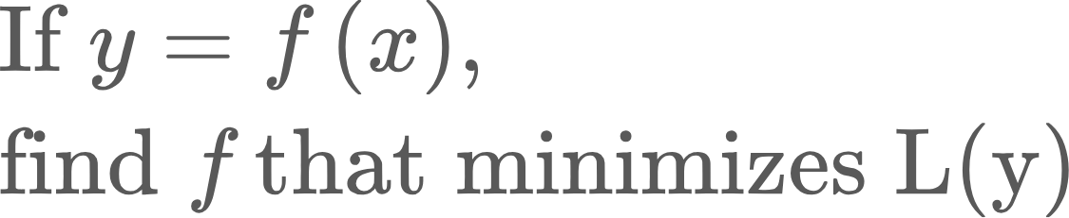
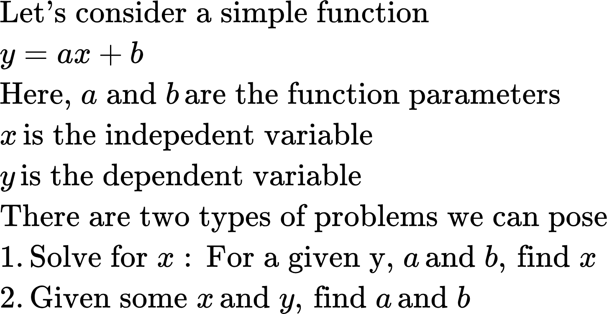
Let’s come back to the optimization problem

Slide 18
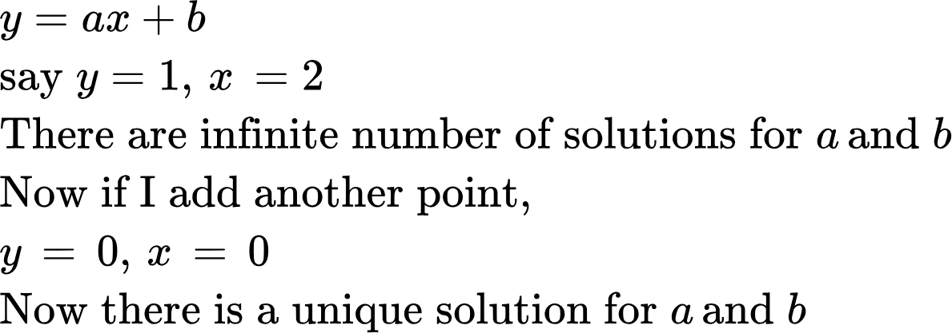
Let’s come back to the optimization problem
Optimization deals with problem 2.
Let’s consider an example
What if there are several points? Now, the best we can do is to find a and b that minimize some distance metric between the points and the line defined by a and b

Slide 19
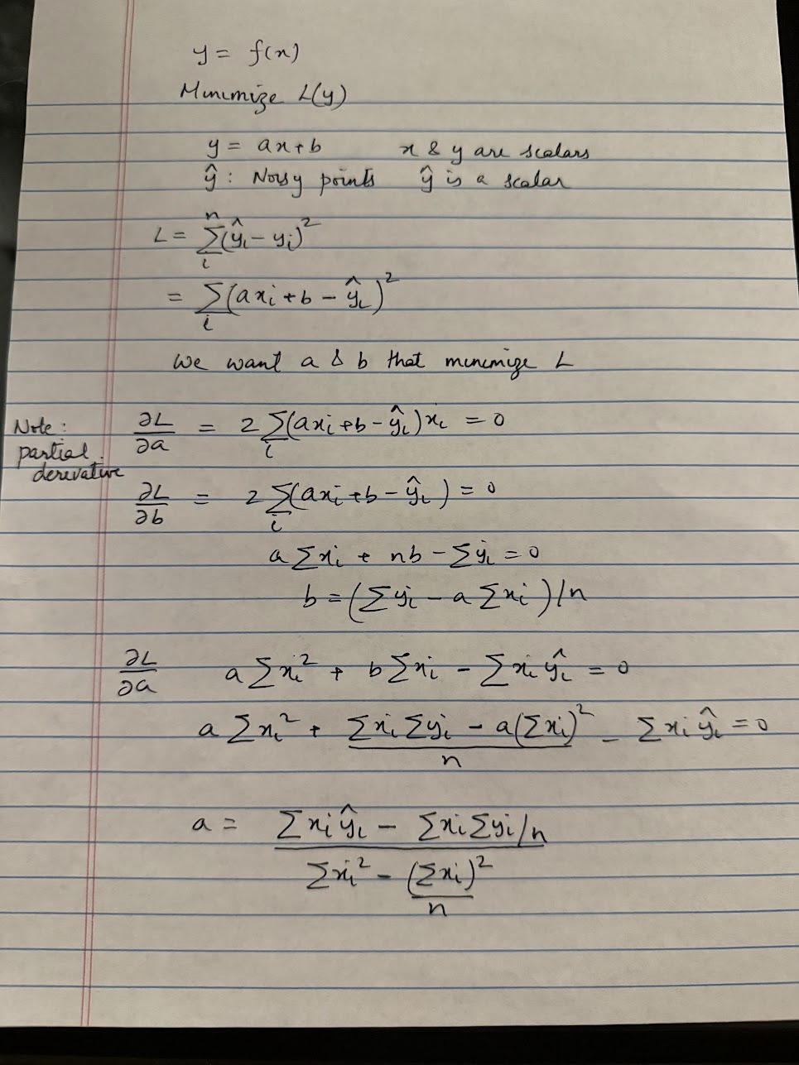
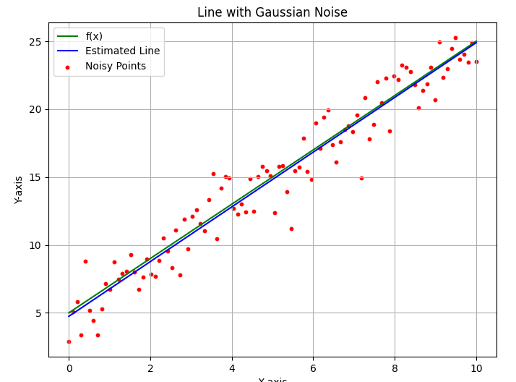
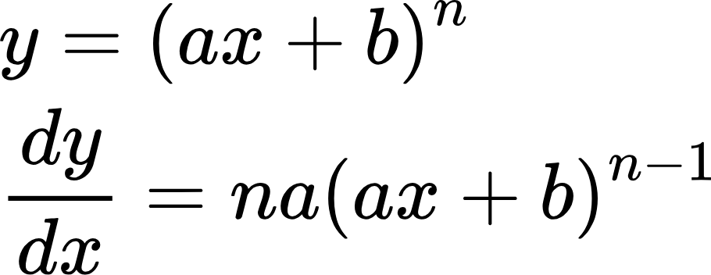
Optimization Example
Let’s now use derivatives to solve a common optimization problem.. Linear regression
Code: linear_regression.py

Slide 20
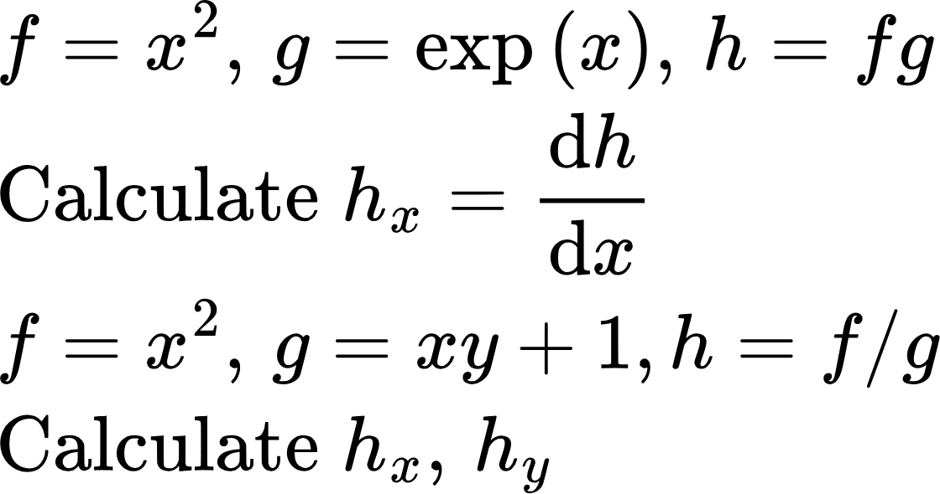
Homework problems
Following slide 15, and verify_partial_derivates.py, calculate following derivatives and verify numerically
All problems in Exercises section 1.4 of Matrix Calculus
Run part 2 of verify_partial_derivatives.py. Make sure you can follow the code and see how it implements the math in Slide 14
Following linear_regression.py, generate points along y=xsin(x) and fit a line. What do you observe
For some reason, we want the intercept b to remain small. How would add this constraint to the regression problem? Solve for optimal values of a and b with this constraint
.

